Slide 1


PROJECT 2: Group 4
WORLD BANK PRESENTATION
GENDER DATABASE ANALYSIS
Presented by:
Ouykhy QUACH
Michel BRUN
Nadim SAAD
Date: Monday Dec. 13th 2021

Slide 2


Project Description
Process
The goal of this project is to:
Create the database that reflects the gender socio-economic subject that we chose
Develop the composite indicator that allows us to compare the objects on a world scale
Implement SQL queries that will return useful insights about our data
STEP 01:
Planning
STEP 02:
ER Model
STEP 03:
Database Schema
STEP 05: Composite Indicator Model
STEP 04:
Queries

Slide 3

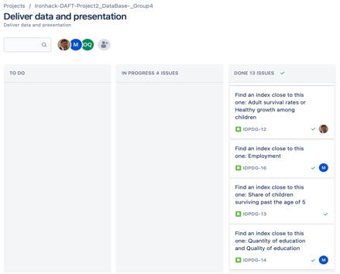
Project Process
STEP 01: Planning
STEP 02:
ER Model
STEP 03:
Database Schema
STEP 04:
Queries
STEP 05: Composite Indicator Model
Discuss the subject and check the available data sources
Make the project planning in Jira (creating a new project for our group)
Create our ER Model
Get the data
Create the data sources description and metadata
Create the database (SQL)
Develop the methodology of our indicators
Implement the queries
Discuss the results
Prepare slides
Finalize our presentation

Slide 4
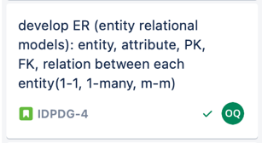
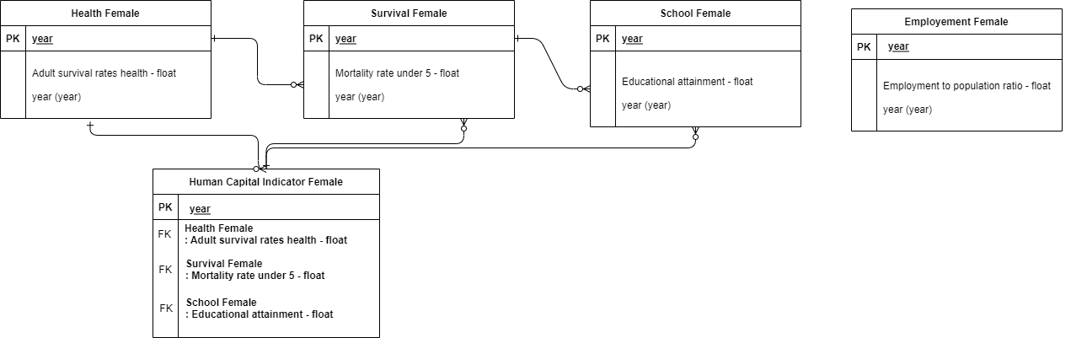
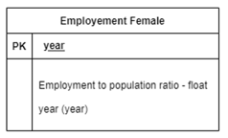
Project Process
STEP 01:
Planning
STEP 02: ER Model
STEP 03:
Database Schema
STEP 04:
Queries
STEP 05: Composite Indicator Model

Slide 5
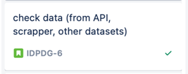
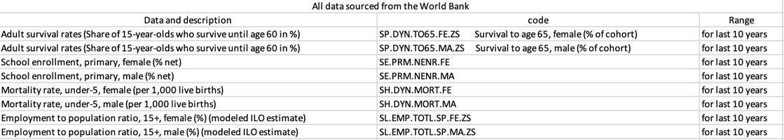
Project Process
STEP 01:
Planning
STEP 03: Database Schema
STEP 02:
ER Model
STEP 04:
Queries
STEP 05: Composite Indicator Model
We started looking in 2 different data sources (World Bank and CIA Factbooks)
We retained the WB data of which we were able to receive via API the relevant data
We chose the below 8 different tables between the years 2008 and 2018

Slide 6

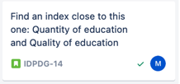


Project Process
STEP 01:
Planning
STEP 04: Queries
STEP 02:
ER Model
STEP 03:
Database Schema
STEP 05: Composite Indicator Model
We performed several queries
Many were dropped because we couldn’t find data over the 10 years that we chose
Finally we wrote the codes on SQL and came up with the results we were seeking
We aimed at the The Human Capital Index.
This World Bank Index (ranking 157 countries) measures:
Which countries are best in mobilizing the economic and professional potential of its citizens
How much capital each country loses through lack of education and health
The HCI ranges between 0 and 1 (1 meaning maximum potential is reached)

Slide 7
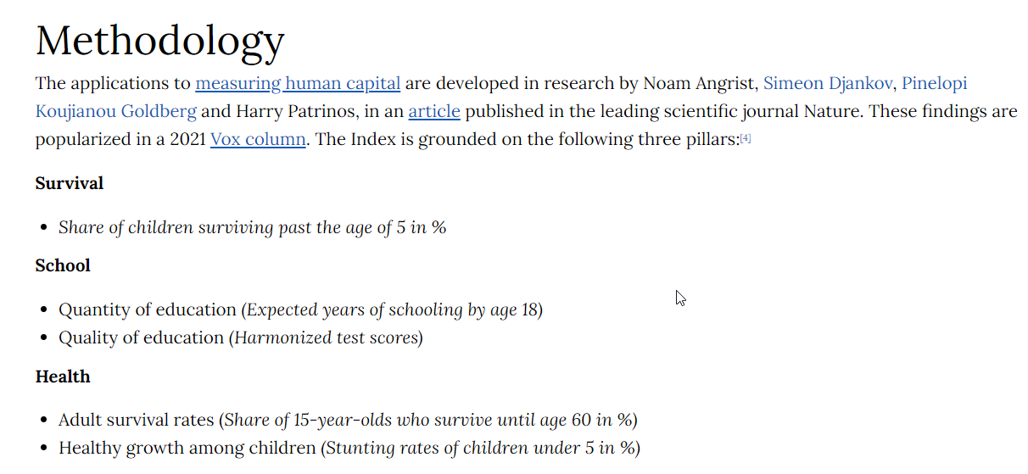
Project Process
STEP 01:
Planning
STEP 04: Queries
STEP 02:
ER Model
STEP 03:
Database Schema
STEP 05: Composite Indicator Model

Slide 8
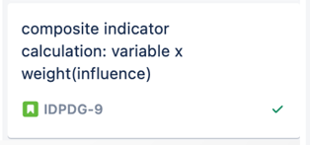
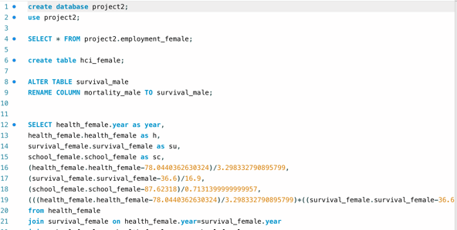
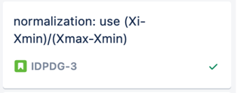
Project Process
STEP 01:
Planning
STEP 05: Composite Indicator Model
STEP 02:
ER Model
STEP 03:
Database Schema
STEP 04:
Queries
We calculated our findings based on the composite indicator calculation
We did the normalization using the formula (Xi-Xmin)/(Xmax – Xmin)

Slide 9
Challenges
Teamwork and distribution of the tasks at hand
Scope the project (Project description steps)
Data collection and evaluation
Tools handling (Jira, Github, Python, SQL, …)
Technical coding and SQL queries difficulties
Extract the results
Draw the graphs
Synthetize and summarize our findings

Slide 10
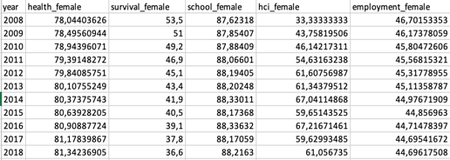
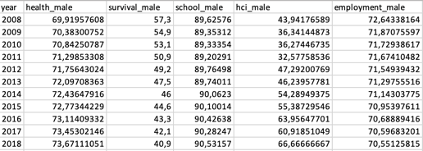
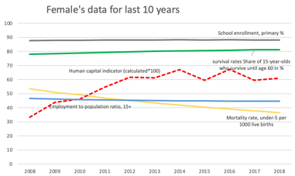
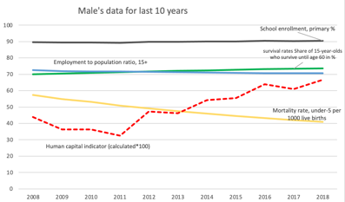

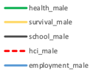
Main Results (Highlights)

Slide 11
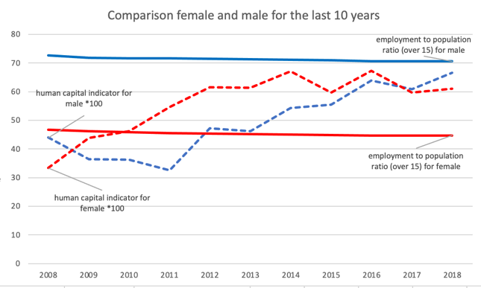
Main Results (Conclusion)
01
Human Capital Indicator (Female)
Went up from 33 % to 61 % over a decade and kept on progressing until 2017 when it dropped below males HCI of that year
02
Human Capital Indicator (Male)
Dropped from 44 % in 2008 to 32 % in 2011 and kept progressing ever since to exceed females HCI in 2017 reaching 67% in 2018
03
Employment to Pop. Ratio Over 15 (Female)
Employment ratio kept steady over a decade revolving around 45 %
04
Employment to Pop. Ratio Over 15 (Male)
Employment ratio kept steady over a decade revolving around 71 %

Slide 12
THANK YOU.

